Slide 1

Zonal Submission
Team Name: RAHI
Contest Theme: PRODUCT FOR RURAL ENTERPRENEURSHIP

Slide 2


Product Name: ONION HARVESTING MACHINE
Team Members: 1. ATHARVA SHIRSATH
2. BHAVIN YARDI
College Name: VISVESVARAYA NATIONAL INSTITUTE OF TECHNOLOGY
Mentor/Professor Name: SHRI. PRASAD VIJAY KANE

Slide 3
DESIGN PHILOSOPHY & APPROACH
Researched on the problems faced by common people.
Focussed on the problems faced by the farmers.
Found the absence of a low-cost and compact Onion Harvesting Machine.
Studied the Onion Harvesting Techniques and Methods in detail and found the absence of provisions to incorporate the curing of onions in any of the existing machines.
Noted down all the processes to be followed to get a Ready-to-Sell onion from the field.
Designed Sub-Assemblies for each of the desired process.
Added all the Sub-Assemblies together in order to complete the ONION HARVESTING MACHINE.

Slide 4
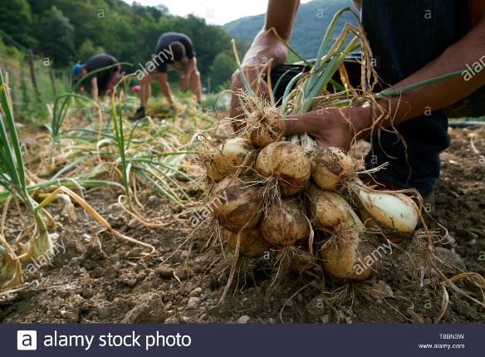
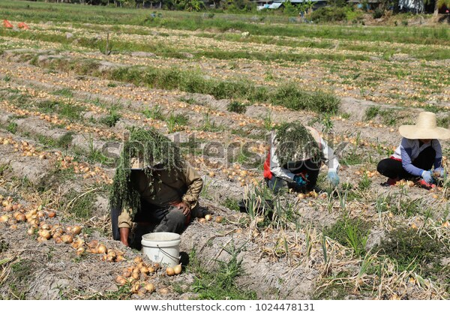
OUR PROBLEM STATEMENT
Expensive
Variable Performance
Low Capacity
MANUAL ONION HARVESTING
Photo Credits -
https://www.alamy.com/france-gard-sumene-hamlet-of-sanissas-establishment-fesquet-producer-of-cevennes-onions-labeled-aop-and-aoc-manual-harvest-image246120445.html
Photo Credits - https://www.shutterstock.com/image-photo/workers-harvest-onions-by-manual-field-1024478131

Slide 5
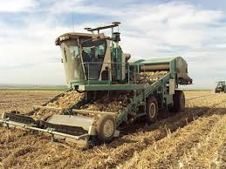
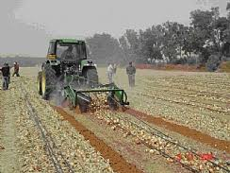
US2531379A Harvester for onions and the like(1945)
EXISTING PRODUCTS
There are several other patents on onion harvesting. In general the present onion harvesting machines consists of conveyer belt and cutting of leaves using rotating unit like gear, razor, rolls, etc. in common.
US3451485A Onion harvesting machine (1966)
Photo Credits - http://www.shuknecht.com/custom-onion-harvesting-equipment.html
WO2020053841A1 Onion harvesting machine with ability to cut stems (2018)
Photo Credits - http://www.israelagri.com/?CategoryID=401&ArticleID=615

Slide 6
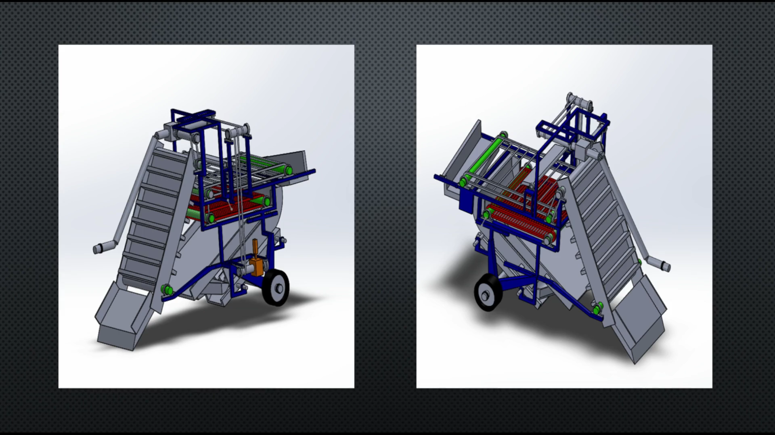
DETAILS OF THE WORKING OF THE PRODUCT

Slide 7
WORKING OF THE PRODUCT
Removing Onions along with the leaves
Digger - The digger digs into the soil and does the work of plucking the onions from the soil and carrying it forward in the machine.
Belt – The Belt carries the onions with the extra soil up for further processing.
Roller 1 – The onions and the soils, then move to Roller 1, where the onions and the small lumps of soil fall down and the large lumps of soil are carried till the end and thrown away. (P.s. – The flap above the roller is provided to stop the onion above a large lump of soil from going forward).
Roller 2 – The onions and soil fall on Roller 2 and the extremely small lumps of soil fall from the roller and are eventually thrown on the ground and the onions are carried forward.
Separator – The onions and soil fall on the separator after Roller 2 and the remaining soil is separated from the onions through the grooves provided at the bottom.
Layout Assembly- The onions are carried forward and are assembled on the ground in a systematic manner because of the convergent structure provided at the end.

Slide 8
WORKING OF THE PRODUCT
Cutting of Onion Leaves
On/Off Switch – After the harvesting of Onions, we store it for around 7-15 days for the curing to take place. After the curing is done, we input the onions back into the machine. This switch is used to switch on the cutting mechanism for the cutting to take place.
Transport of Onions - The harvested onions are now directly placed on the conveyer belt and travel till the separator in the same way as mentioned in Step 2,3,4 & 5 of the previous slide.
Cutter - The cutter operates on the slider crank mechanism with the blades as the piston. It keeps on reciprocating and cuts the leaves that come in contact with it through the grooves.
Layout Assemble – After the cutting of leaves, the onions come down through the separator and the leaves come down from the structure beneath it. The onions are laid down in a patch and the leaves are laid down on both sides of the onions because of the convergent-divergent structure.

Slide 9
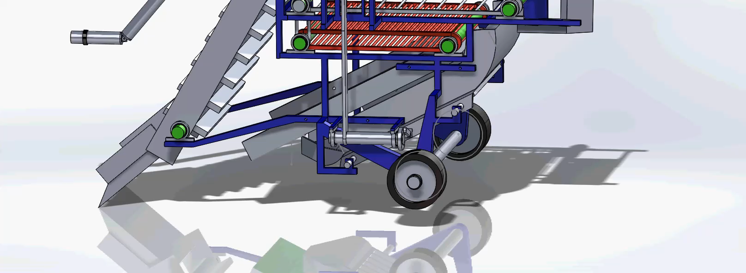
WORKING SIMULATION OF THE CUTTING MECHANISM

Slide 10
DESIGN CONSIDERATIONS
Separator is made of Aluminum.
Since, the onions are forced to go down by the virtue of gravity.
Separator Angle should be greater than Angle of Repose
Angle of Separator = 27°
Angle of Repose = 24°
Since, Angle of Separator > Angle of Repose
∴ Onions will slide down
In the Slider Crank Mechanism,
Length of Crank (r) = 7cm
Length of Connecting rod (l) = 21cm
∴ n = l/r = 3
Range of (n) for efficient design = 3 - 5

Slide 11
DESIGN CONSIDERATIONS
Force required to cut the leaves = 9kN 1
Inertia force on the piston = 17.14kN 2
Since, 2 > 1
∴ The cutting of onions can take place.
Designed the Convergent – Divergent Structure at the end to lay down the onions in the centre and the leaves on its both sides to ensure the separation of the onions and its leaves.

Slide 12
DESIGN CONCEPTS
Power utilized in cutting the onion leaves against its Shear Strength
Power utilized in transporting the onions from the ground till the rollers against the force of Gravity
Total Power supplied by the PTO**
Total Excess Fuel required by the Tractor to complete the process
Total Additional Cost required to complete the machining process
**This total power does not include the power required to drive the tractor against the resistance offered by the soil as that can only be found out experimentally.

Slide 13
DESIGN CALCULATION RESULTS
(Calculations per Acre of Land)
Rate of work done on the belt | P₁ | 10.639 kW
Max. Power reqd. for cutting | P₂ | 48.467kW
Total Power required | P | 69.745kW
Mass of fuel required | ṁ_{f} | 0.00051kg/s = 0.3 kg/min
Total Fuel required | M_{f} | 7.5kg
Total Volume of Fuel required | V_{f} | 9L
Total Cost | C | ₹720/-

Slide 14
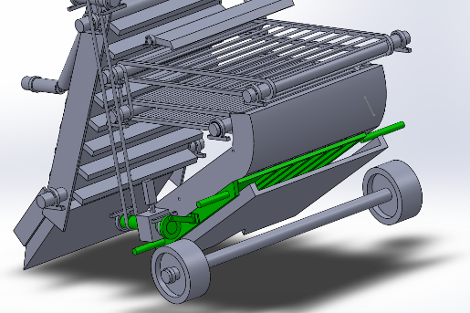
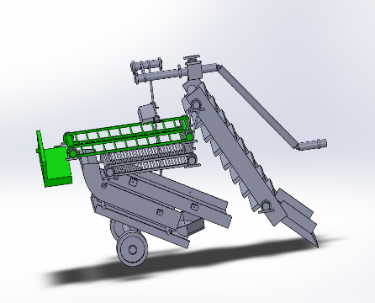
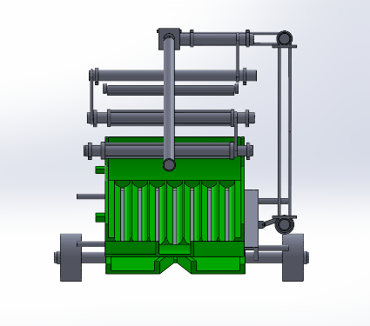
BENEFITS OF OUR PRODUCT
Introduction of Slider Crank Mechanism which involves a number of plane blades attached to single crank instead of the conventional gear mechanism for cutting of leaves improves the mechanical efficiency, reduces the cost and also reduces the manufacturing complexity of the component.
Use of the harvested space of the farm to systematically lay down the separated onions and leaves.
Single machine which can independently and separately carry out the harvesting of onions and cutting of leaves which incorporates a provision for Curing of onions.
The product incorporates an efficient way for the disposal of big lumps of soil.

Slide 15
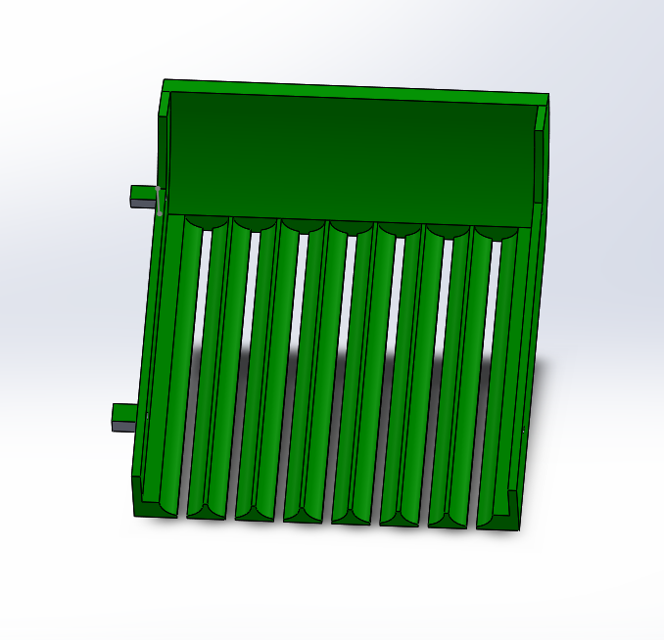
DRAWBACKS OF THE PRODUCT / OPTIMIZATION POSSIBLE
At times, due to less vibration the lumps of soil may not break into very fine particles and may not separate through the pores of the Separator.
Inclusion of Provision of a Sorting mechanism for the onions can be possible.
In the Second stage, i.e. the cutting of leaves, the onions need to go through the entire process again which can be avoided.
At times, the onion may not change its orientation in a way that its leaves come out of the groove, which may result in some leaves not being cut, thus, reducing the efficiency.

Slide 16
MARKET SURVEY
Machine Name | Machine Price | Machine Functioning
Anon diesel engine power callions and spring Onion Harvesting Machine | US $5600 - $8200 / set = ₹6Lakhs | Remove the Onions from ground.
Koppert Machines- Onion Harvester | €67,500 / piece=₹60Lakhs | Remove the onions + Cut the leaves
Manual Labour Details -
Cost of Labor for Onion Harvesting – ₹7000 / Acre.
Time required for Harvesting – 7 days for 2.5 Acres with 12 workers.

Slide 17
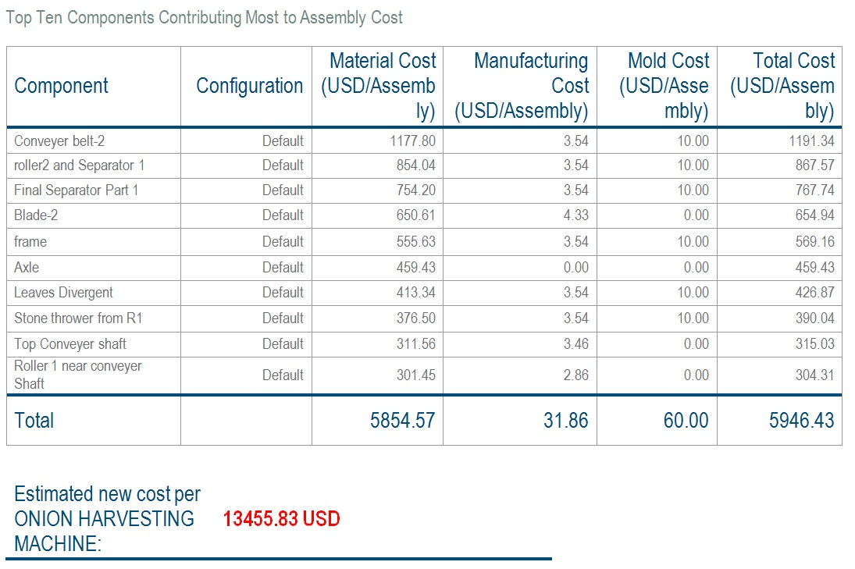
Cost Report

Slide 18
RETURN ON INVESTMENT (ROI)
Profit earned by owner | ₹2800/Acre
Profit earned by owner in 10years | ₹92.7lakhs
Maintenance cost | ₹2.7Lakhs
Net Profit earned by owner in 10 years | ₹90Lakhs
ROI | 8
Profit earned by Farmer | ₹4000/Acre

Slide 19
References -
1 - Chickering, Earnest E. "Harvester for onions and the like." U.S. Patent No. 2,531,379. 28 Nov. 1950.
2 - James, Frank C. "Onion harvesting machine." U.S. Patent No. 3,451,485. 24 Jun. 1969.
3 - Hiroshi, Tateyama. "Onion harvester machine." U.S. Patent No. 2,625,781. 20 Jan. 1953.
4 - SOLTANABADİ, M. H., ABDOLAHPUR, S., & TAKİ, O. (2012). The Effects of Loading Conditions on Strength and Energy Requirement for Onion Leaf Removing. International Journal of Natural & Engineering Sciences, 6(3).
5 - Gomaa, A. E., Mohamed, H. H., El Gwady, A. A., & Al-Aseebee, M. D. (2014). Evaluation of Tractor Diesel Engine Performance using Biodiesel from Three Different Individual Sources. Misr J. Ag. Eng, 31(2), 403-424.
6 -El-Ghobashy, H., Bahnasawy, A. H., Ali, S. A., Afify, M. T., & Emara, Z. (2012). Development and evaluation of an onion peeling machine. Misr J. Agric. Eng, 29(2), 663-681
7 - Dabhi, M., & Patel, N. (2017). Physical and mechanical properties of Talaja red onion cultivar. Bioprocess Engineering, 1(4), 110-114.

Slide 20
All the Reports that have been mentioned in the above slides are the results of calculations performed. The Reports showing the entire detailed calculations have been submitted separately in a folder. Please do refer to that for detailed analysis.
This brings us to the end of the presentation of the ONION HARVESTING MACHINE.
Through this presentation, we have tried to present our product in a very simple and easy to understand manner.
Thank you for giving us your precious time and going through the entire presentation.
-Made by
Team RAHI

